Slide 1

OPORD 21
Operation *********************
TS // SI // NOFORN
PHASE-1
ID
OO21-9-TIP-R-B
LOCATION
STUBBHULT
DATE
LAT
LONG
PRELIM
GATHERED BY
ISC-OPS-2101#R007
TIME
GRID
ISC OPS VERIFIED
RLY // 77th JSOC
CTRL + F5

Slide 2
INFO
STUBBHULT PROVINCE
TS // SI // NOFORN
PHASE-1
ID
OIR-2KXX5-21-00
LOCATION
STUBBHULT
DATE
09/21/2025
LAT
56.965851
LONG
13.3751075
PRELIM
GATHERED BY
MSA-14H#61
TIME
21:27 Z
GRID
084 267
ISC OPS VERIFIED
RLY // 77th JSOC
Event Timeline
Late 2022: The ultranationalist "Svea Rike" movement gains political traction, advocating for national technological sovereignty and a self-reliant approach to defense systems and anti-NATO sentiment.
February 2023: Svea Rike wins a historic majority in the general election, establishing a new government and taking steps to consolidate critical infrastructure under state oversight.
June 2023: The government forms the Cybernetic Operations Response Force (CORF). Col. Magnus Thorsten is appointed to lead its Special Operations branch, Virtual Intervention & Response Unit (VIRUS) tasked with rapid-response scenarios involving emerging threats to national security.
January 2024: Ministry of Defence announces a strategic partnership with private defense contractor ION Inc. to "modernize defensive capabilities." ION begins embedding and with and training the Stubbhult Armed Forces in the region.
2024-2025: ION's role expands dramatically. They are observed procuring and operating advanced UAV and UGV platforms, and integrating a proprietary battlefield network for Stubbhult Armed Forces and experimental cybersecurity protocols.
July 2025: Reports emerge of a major incident in the rural town of Yttre Mjala. Official describe a "training accident." However, satellite imagery and signals intelligence indicate to a likelihood of a large-scale, hostile drone swarm event. Civilian and military casualties are estimated in the hundreds. ION and VIRUS units in full combat gear deployed to contain the incident, assess damages, and secure sensitive technology under a media blackout.
August 2025: Allied intelligence consensus assesses the Balshult event as the first live fire test of a clandestine Autonomous Swarm Weapons System. The level of technological sophistication suggests extensive, off-the-books development.
September 2025: CIA asset "Songbird" confirms that Colonel Thorsten will visit the CORF/VIRUS Balshult facility to oversee ongoing operations and the report from the investigation following the incident. Additional security provided by ION personnel in coordination with CORF was observed.

Slide 3
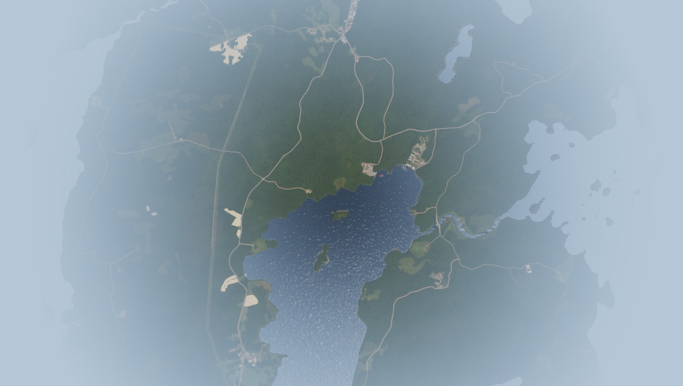

INFO
STUBBHULT PROVINCE
TS // SI // NOFORN
PHASE-1
ID
OIR-2KXX5-21-01
LOCATION
STUBBHULT
DATE
09/21/2025
LAT
56.965851
LONG
13.3751075
PRELIM
GATHERED BY
MSA-12D#542
TIME
21:27 Z
GRID
084 267
ISC OPS VERIFIED
RLY // 77th JSOC
SATELLITE VIEW OF PRIMARY AO

Slide 4
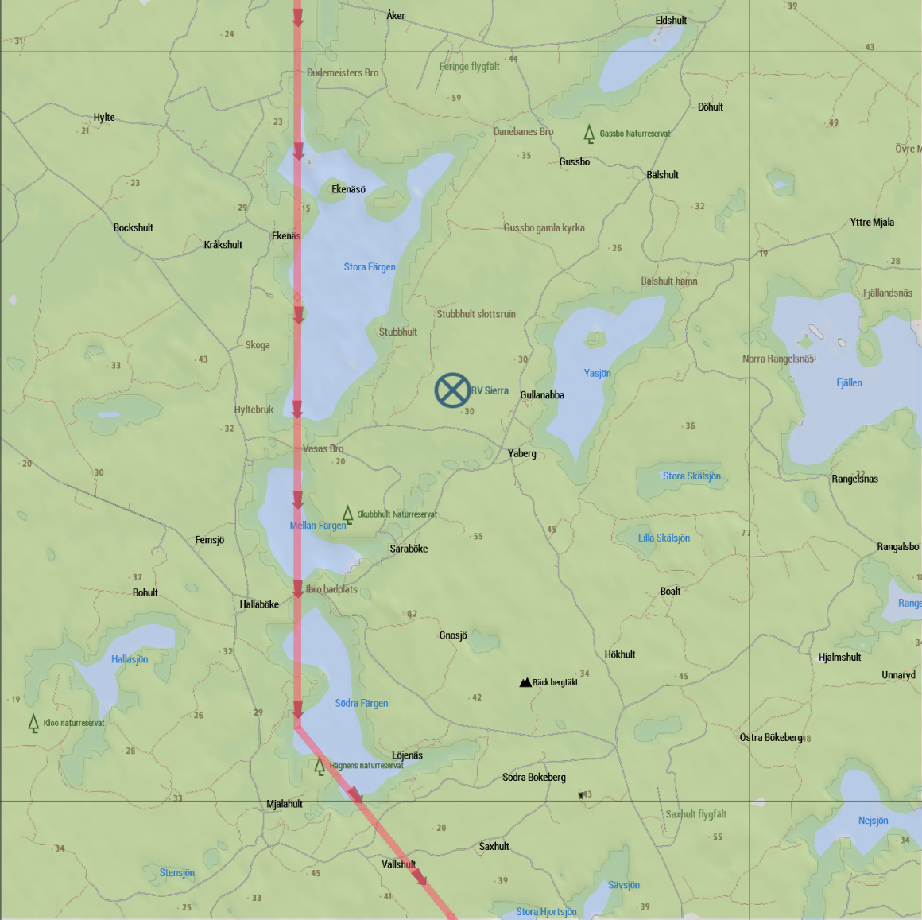
INTEL
STUBBHULT PROVINCE
TS // SI // NOFORN
PHASE-1
ID
IM-2K2521-01
LOCATION
STUBBHULT
DATE
09/23/2025
LAT
56.965851
LONG
13.3751075
PRELIM
GATHERED BY
MSA-12D#135
TIME
21:27 Z
GRID
084 267
ISC OPS VERIFIED
RLY // 77th JSOC
FLIGHT PATH AND RV POINT SIERRA

Slide 5
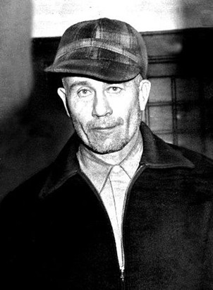
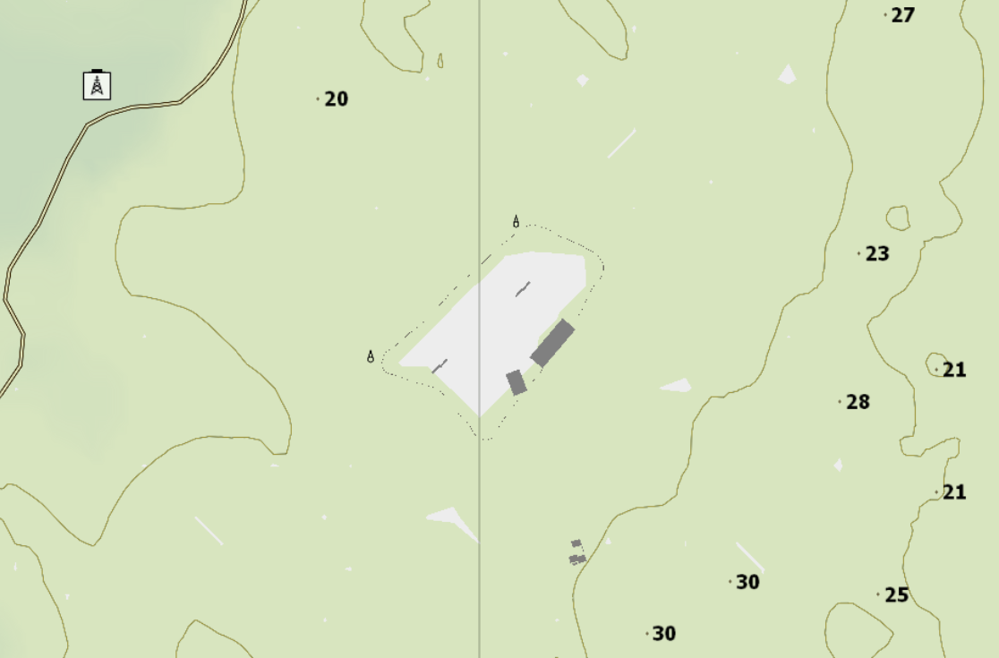
TARGET
SONGBIRD
TS // SI // NOFORN
PHASE-1
ID
IT-2KXX521-01
LOCATION
STUBBHULT
DATE
09/25/2025
LAT
56.965751
LONG
13.3751175
PRELIM
GATHERED BY
MSA-13A#400
TIME
11:32 Z
GRID
060 254
ISC OPS VERIFIED
RLY // 77th JSOC
STATUS: ACTIVE
TARGET INFORMATION
Recruited by AJ200282 in 2020 after getting caught trying to smuggle copper wires as industrial waste.
Has access to most non-sensitive remote bases for delivering food and other supplies as a contractor / driver.
Provides information in exchange for arming the local rebellion with guns and ammo.
Low pain tolerance limit. Likely to crack under interrogation.
Last contact made 6 hours ago with tasking to meet US Forces at the RV Point Sierra
PHYSICAL DESCRIPTION
PID: THE LIGHT IS BLUE
TARGET SUMMARY
Age: Late 30s
Height: 186 cm (6’0”)
Hair: Steel-grey, cropped short in a severe, functional military style.
Eyes: Pale blue.
Typical Attire: T Shirt and Trousers.
SOURCE:
A rebel thief turned CIA Informant. Smuggles intel from low level remote bases. Proficient in using a disguise and blending in easily.
LOCATION:
EVIDENCE(S):
TRIGGER:
TASK
FRIENDLY
RENDEZVOUS

Slide 6
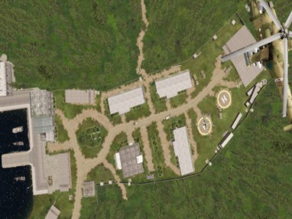
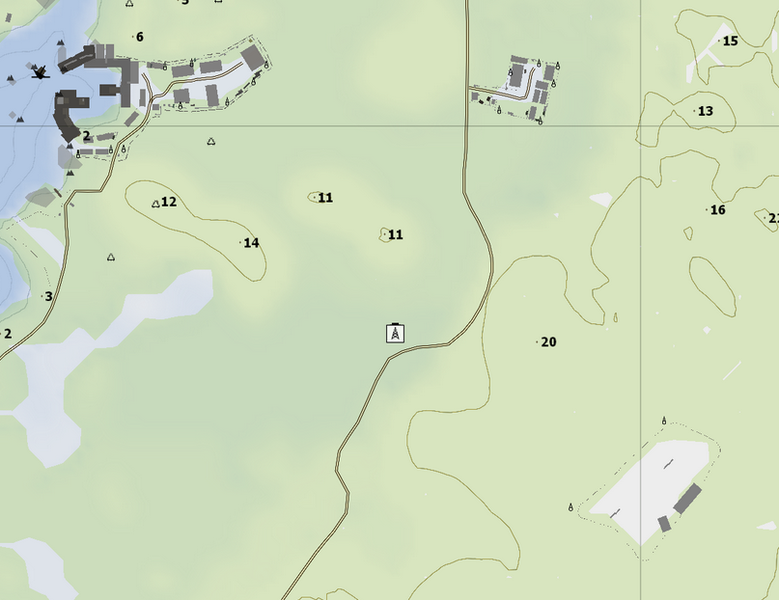
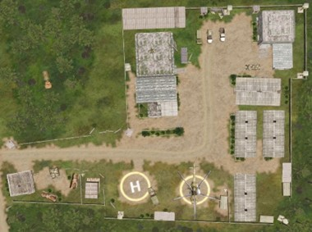

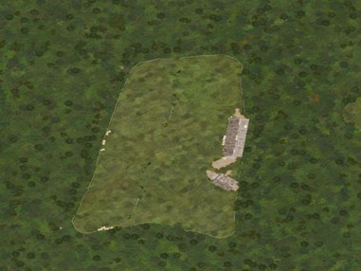
INTEL
RV SIERRA
TS // SI // NOFORN
PHASE-1
ID
IM-2K2521-02
LOCATION
STUBBHULT
DATE
09/21/2025
LAT
56.965851
LONG
13.3751075
PRELIM
GATHERED BY
MSA-12D#135
TIME
21:27 Z
GRID
084 267
ISC OPS VERIFIED
RLY // 77th JSOC
SATELLITE VIEW OF RV SIERRA AND NEARBY POIs
MG AA
Shilka
BTR-80
MTLB (Ambulance)
BMP-2K
Mi-8
UGV
Mi-24G
2x RHIB
1x Unmanned Boat Vehicle
RV Point Sierra

Slide 7
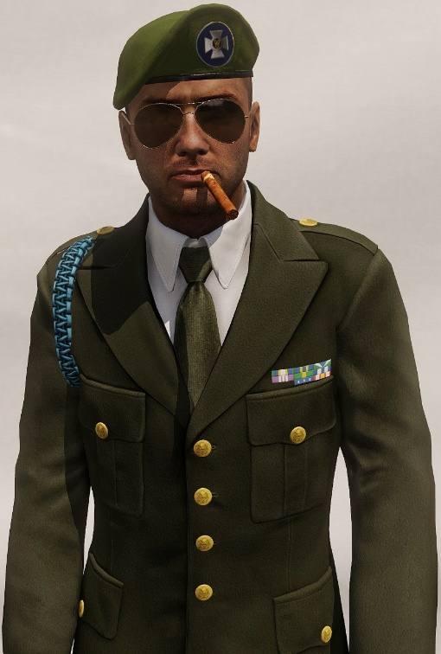
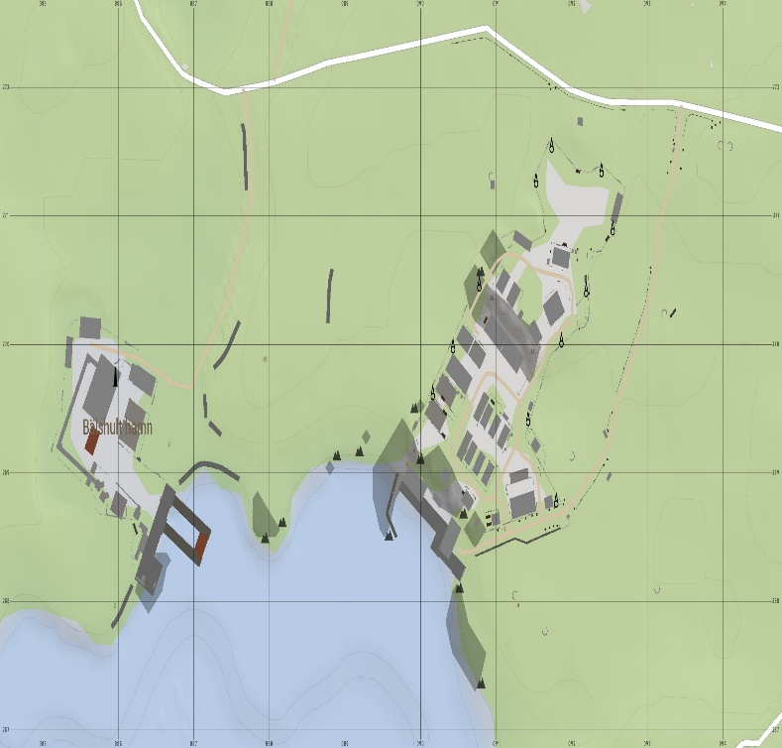
TARGET
COLONEL MAGNUS THORSTEN
TS // SI // NOFORN
PHASE-1
ID
IT-2KXX521-02
LOCATION
STUBBHULT
DATE
09/25/2025
LAT
56.965751
LONG
13.3751175
PRELIM
GATHERED BY
MSA-16C#212
TIME
16:16 Z
GRID
091 269
ISC OPS VERIFIED
RLY // 77th JSOC
STATUS: ACTIVE
TARGET INFORMATION
Commanding Officer of the Virtual Intervention & Response Unit Sierra (VIRUS) of the Grozovian Armed Forces.
Very tech savvy. Known to always carry a SATCOM Cell Phone.
Constantly protected by a dedicated team of ION PMC operatives. This detail is exceptionally well-equipped, proficient in close protection, and has standing orders to use lethal force preemptively against any perceived threat.
Believes in hands-on leadership. Frequently tours research and outbreak sites, making him vulnerable outside of the primary fortified laboratory complex.
PHYSICAL DESCRIPTION
PID:
TARGET SUMMARY
Age: Early 40s
Height: 188 cm (6’2”)
Hair: Steel-grey, cropped short in a severe, functional military style.
Eyes: Pale blue.
Typical Attire: Decorated Parade Dress.
SOURCE:
The architect of Stubbhult's clandestine bioweapons program. A brilliant but amoral scientist-turned-commander who views his work as a strategic necessity.
LOCATION:
EVIDENCE(S):
TRIGGER:
TASK
HOSTILE
KILL / CAPTURE

Slide 8
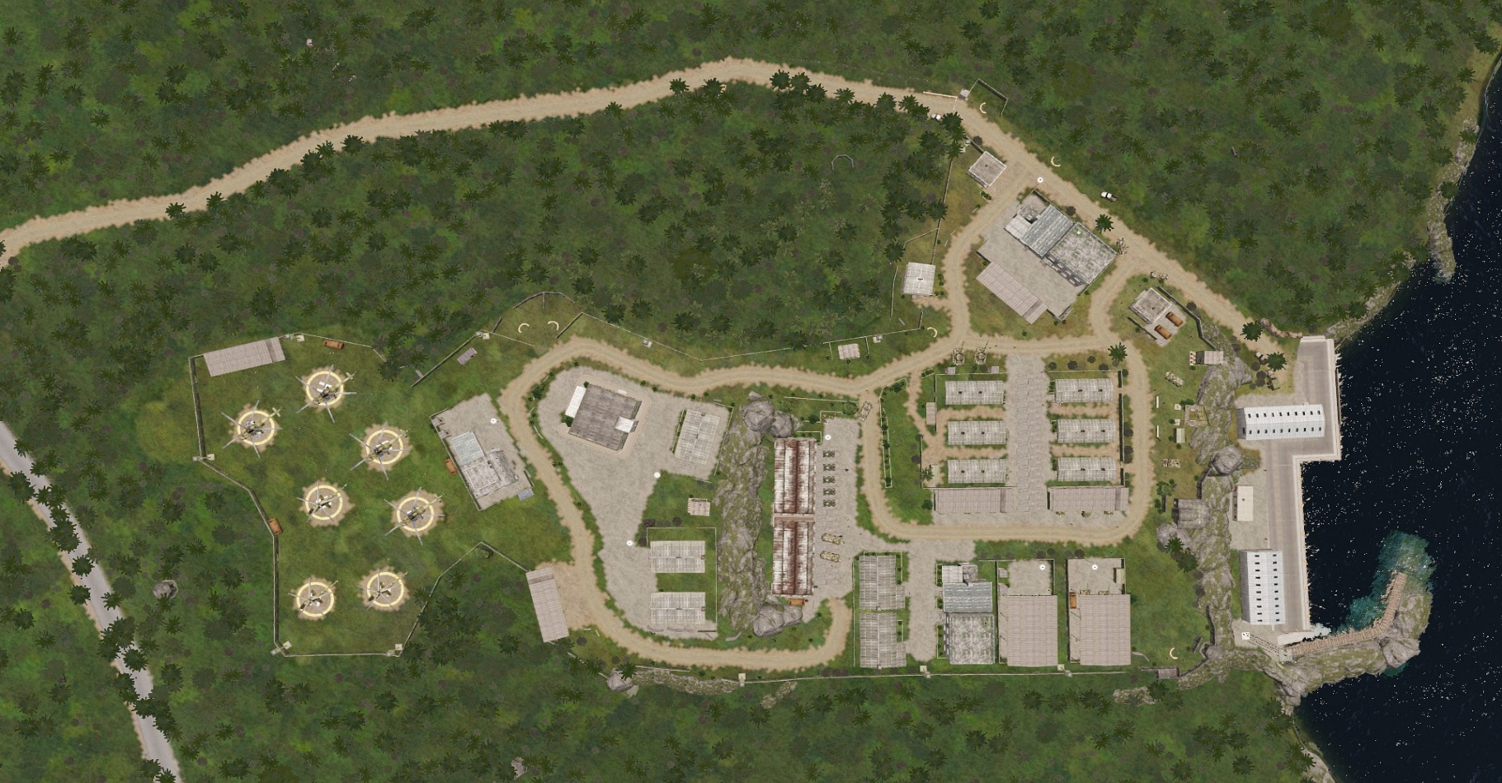
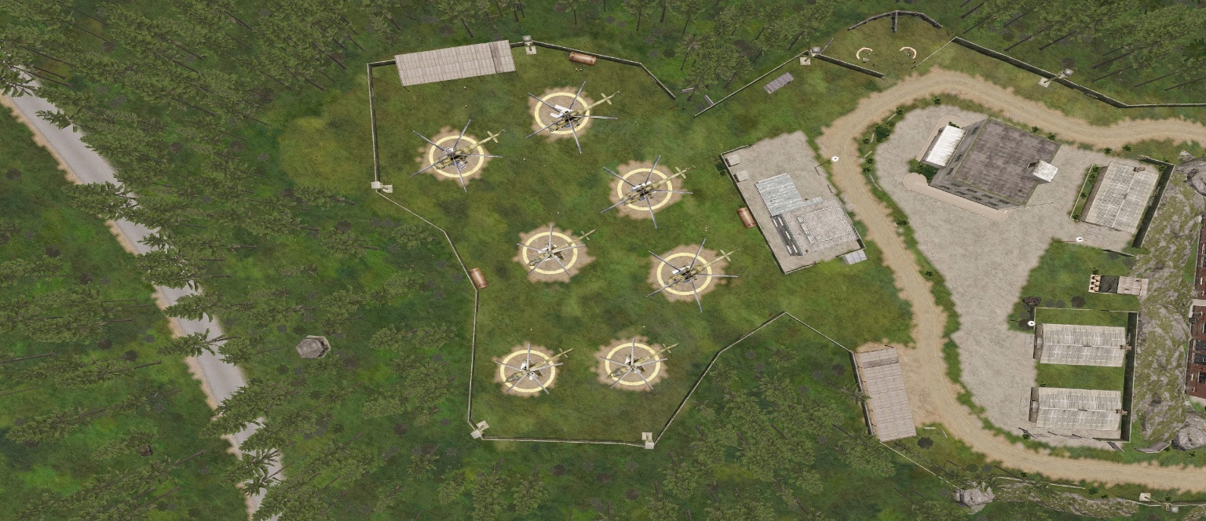
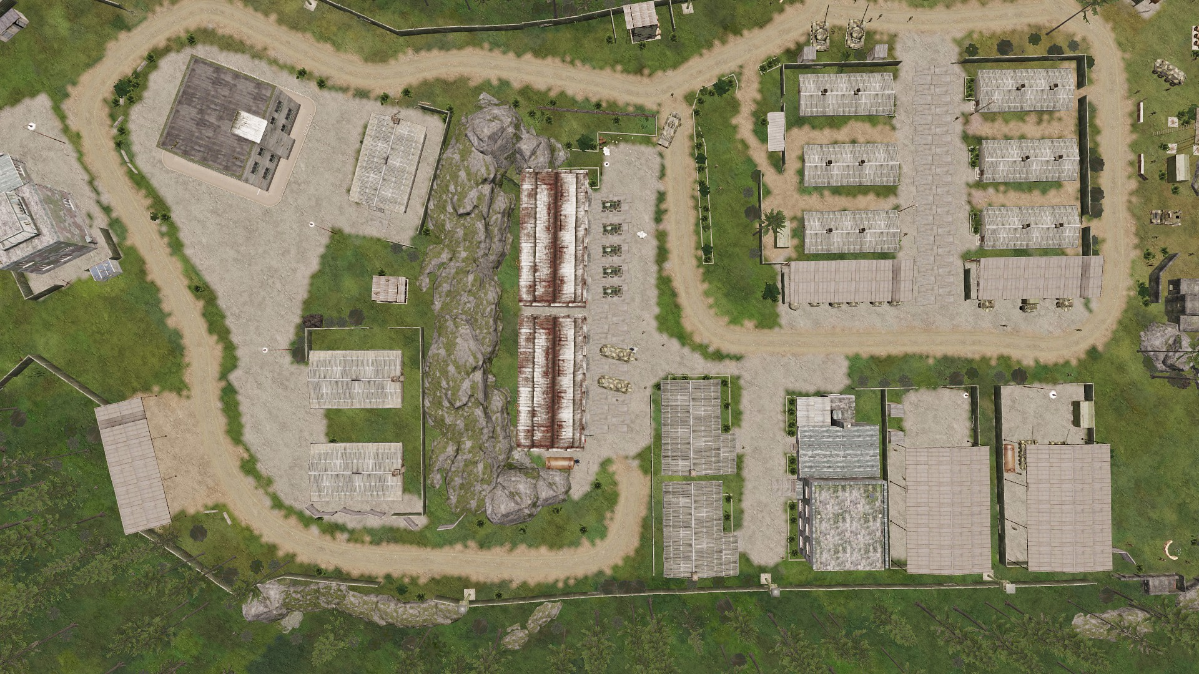
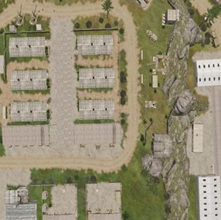
INTEL
STRONGHOLD
TS // SI // NOFORN
PHASE-1
ID
IM-2K2521-03
LOCATION
STUBBHULT
DATE
09/21/2025
LAT
56.965851
LONG
13.3751075
PRELIM
GATHERED BY
MSA-12D#135
TIME
21:27 Z
GRID
084 267
ISC OPS VERIFIED
RLY // 77th JSOC
SATELLITE VIEW OF STRONGHOLD - 10 DAYS AGO
Sizeable Presence of Unmanned Ground Vehicles
T-72
Radar
Sizeable Presence of Helicopters of Various Types
Large Presence of IFVs and Armored Vehicles
Shilka

Slide 9
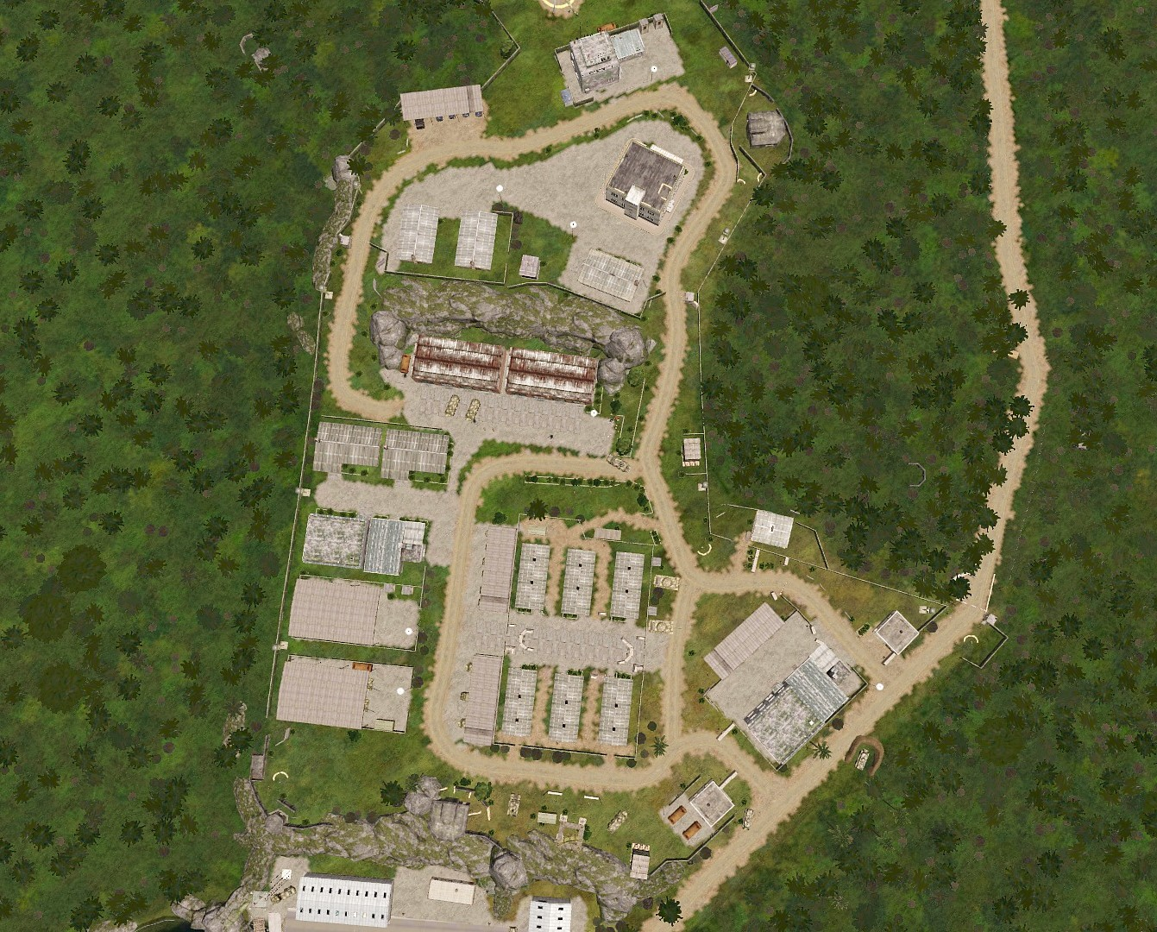
INTEL
STRONGHOLD
TS // SI // NOFORN
PHASE-1
ID
IM-2K2521-03
LOCATION
STUBBHULT
DATE
09/21/2025
LAT
56.965851
LONG
13.3751075
PRELIM
GATHERED BY
MSA-12D#135
TIME
21:27 Z
GRID
084 267
ISC OPS VERIFIED
RLY // 77th JSOC
SATELLITE VIEW OF STRONGHOLD - 48 HOURS AGO
Sizeable Presence of Unmanned Ground Vehicles
T-72
Radar
Sizeable Presence of Helicopters of Various Types
Large Presence of IFVs and Armored Vehicles
Shilka

Slide 10
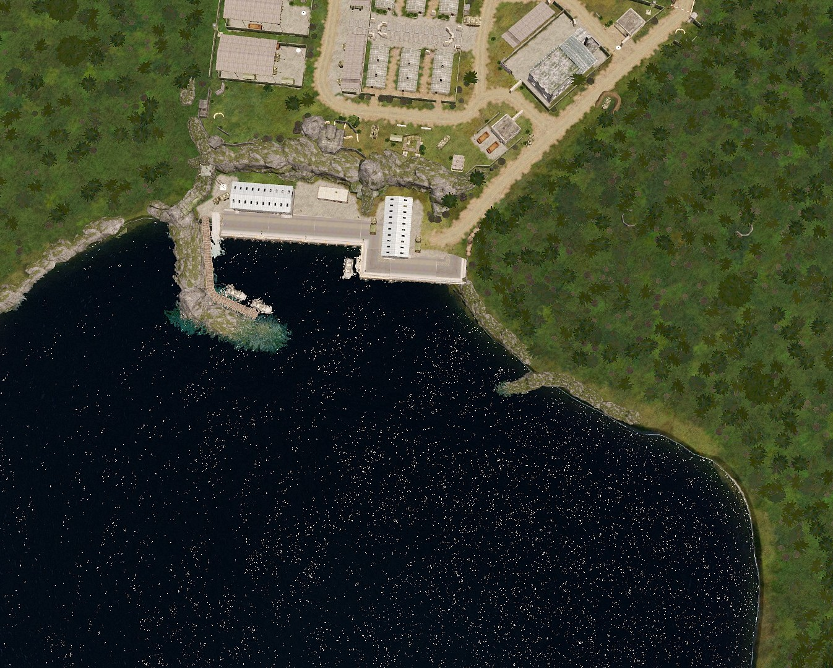
INTEL
STRONGHOLD
TS // SI // NOFORN
PHASE-1
ID
IM-2K2521-03
LOCATION
STUBBHULT
DATE
09/21/2025
LAT
56.965851
LONG
13.3751075
PRELIM
GATHERED BY
MSA-12D#135
TIME
21:27 Z
GRID
084 267
ISC OPS VERIFIED
RLY // 77th JSOC
SATELLITE VIEW OF STRONGHOLD - 48 HOURS AGO
Sizeable Presence of Unmanned Ground Vehicles
T-72
Radar
Sizeable Presence of Helicopters of Various Types
Large Presence of IFVs and Armored Vehicles
Shilka

Slide 11

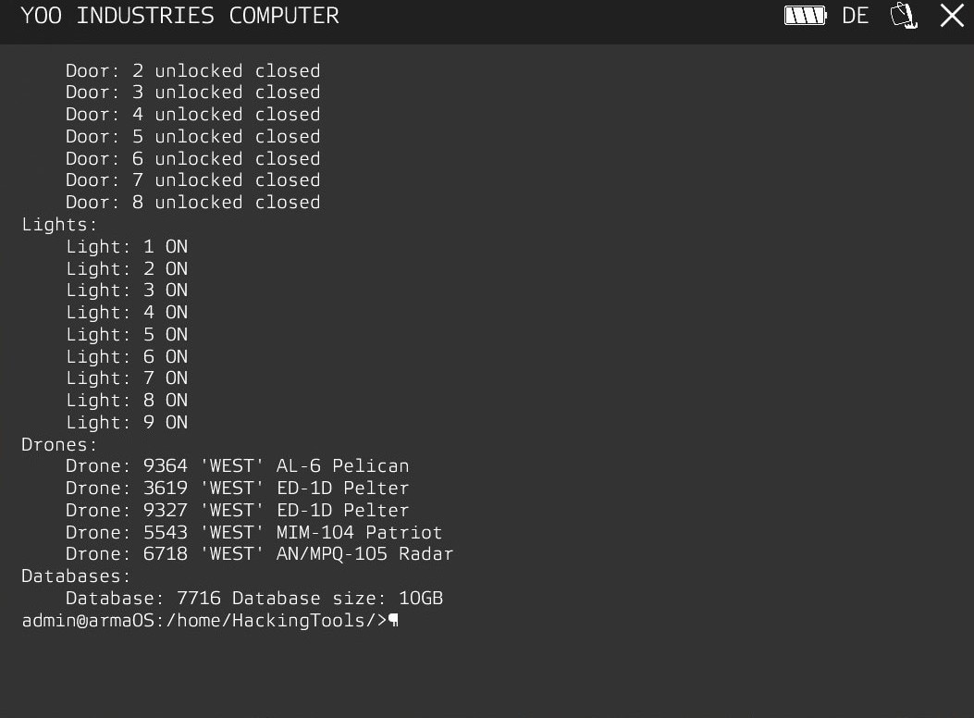
TOOL
RUBBER DUCKY
TS // SI // NOFORN
PHASE-1
ID
OTS-7001-#4K-NSA-1337
LOCATION
DATE
LAT
LONG
PRELIM
GATHERED BY
TSD-H#CK420
TIME
13:37 Z
GRID
TSD OPS IFD APPROVED
RLY // 77th JSOC
STATUS: EXPERIMENTAL
TOOL INFORMATION
Type "cat guide" to display this in game
Type "devices" to list all devices you can hack into.
Type "door BuildingID DoorID (ID or "a" for all) lock/unlock" to lock/unlock doors. Ex: "door 4514 2 lock" or "door 4514 a unlock’
Type "light LightID (ID or "a" for all) off/on" to turn lights off or on. Ex: "light a on" or "light 3 off’
Type "changedrone DroneID (ID or "a" for all) side (west/east/guer/civ)" to switch the side of a drone. Ex: "changedrone 2 east’
Type "disabledrone "DroneID (ID or "a" for all)" to disable (explode) the drones. Ex: "disabledrone 2" or "disabledrone a’
Type "download FileID" to download the File into the folder "Files". Ex: "download 1234"
DEFAULT USERNAME: ADMIN
TOOL SUMMARY
DEFAULT PASSWORD: ADMIN123
Experimental NSA tool used to intercept and modify communication signals from the region. Creates a local administrator account in compatible laptops to allow any operator to exploit its capabilities. Likely to consume battery charge per execution.
TOOL LOCATION: /rubberducky/tools
OPEN MANUAL: CAT GUIDE
TASK
INTERCEPT HOSTILE SYSTEMS

Slide 12
INTEL
THREAT ASSESSMENT
TS // SI // NOFORN
PHASE-1
ID
IM-2K2521-04
LOCATION
STUBBHULT
DATE
09/21/2025
LAT
56.965751
LONG
13.3751175
PRELIM
GATHERED BY
MSA-25B#857
TIME
10:00 Z
GRID
ISC OPS VERIFIED
RLY // 77th JSOC
THREAT
DESCRIPTION
LIKELIHOOD
CONFIDENCE
ANTI AIR
ANTI-AIR DEFENSE SYSTEMS INCLUDING VEHICLES, HAND PORTABLE LAUNCHERS, AND SAM SYSTEMS.
HIGH
HEIGHTENED READINESS IN THE PAST FEW DAYS WITH MORE EXERCISES AND TRAINING
COMMUNICATION
ELECTRONIC COMMUNICATION JAMMING AND INTERCEPTION
HIGH
USAGE AND DEPLOYMENT TO LOCATE AND COUNTER REBELS, REBEL ATTACKS
UNMANNED SYSTEMS
UNMANNED AERIAL VEHICLES, GROUND VEHICLES, TURRETS, CAMERAS
HIGH
PUBLIC ACCOUNTS AND SATELLITE SIGHTINGS OF THESE SYSTEMS DEPLOYED
ROAD BLOCKS
CHECKPOINTS, PHYSICAL OBSTRUCTIONS TO BLOCK FRIENDLY FORCES FROM UTILIZING ROADS
LOW
INTELLIGENCE AND SATELLITE IMAGES SHOWS LIMITED CHECKPOINTS AND ALMOST NO ROADBLOCKS
IED
ROADSIDE EXPLOSIVE DEVICES OF VARIOUS TYPES
LOW
NO DOCUMENTED OR ANALYZED EVENT FOUND
FAST ATTACK AIRCRAFTS
FAST MOVING JETS AND AIRCRAFTS CAPABLE OF CAS, CAP, MULTIROLE AND OTHER OPERATIONS
MEDIUM
DEPLOYED PRIMARILY TO PROVIDE ADDITIONAL SURVEILLANCE AND JAMMING OPERATIONS. FULL SCALE DEPLOYMENT YET TO BE DOCUMENTED
CIVILIAN PRESENCE
CIVILIAN TRAFFIC, MOVEMENT, PRESENCE, INTERACTION, ENCOUNTER
LOW
THE TOWNS ARE LOCATED FAR APART AND OFF THE PATH OF FRIENDLY FORCES, MAKING CIVILIAN ENCOUNTERS UNLIKELY.

Slide 13
OPORD 21
Operation *********************
TS // SI // NOFORN
PHASE-1
ID
OO21-9-TIP-R-E
LOCATION
STUBBHULT
DATE
LAT
LONG
PRELIM
GATHERED BY
ISC-OPS-2101#R007
TIME
GRID
ISC OPS VERIFIED
RLY // 77th JSOC
CTRL + F5

